Slide 1
Unit-4
Remaining Topic

Slide 2
AsyncTask
In Android development, handling background tasks and UI updates is essential for building responsive applications. AsyncTask and Handler are two fundamental mechanisms that developers can use to manage background tasks and UI updates effectively.
AsyncTask class is used to do background operations that will update the UI(user interface). Mainly we used it for short operations that will not effect on our main thread.

Slide 3
AsyncTask
In Android, AsyncTask (Asynchronous Task) allows us to run the instruction in the background and then synchronize again with our main thread. This class will override at least one method i.e doInBackground(Params) and most often will override second method onPostExecute(Result).

Slide 4
Need of AsyncTask In Android:
By default, our application code runs in our main thread and every statement is therefore execute in a sequence.
If we need to perform long tasks/operations then our main thread is blocked until the corresponding operation has finished. For providing a good user experience in our application we need to use AsyncTasks class that runs in a separate thread.
This class will executes everything in doInBackground() method inside of other thread which doesn’t have access to the GUI where all the views are present.
The onPostExecute() method of this class synchronizes itself again with the main UI thread and allows it to make some updating. This method is called automatically after the doInBackground method finished its work.

Slide 5
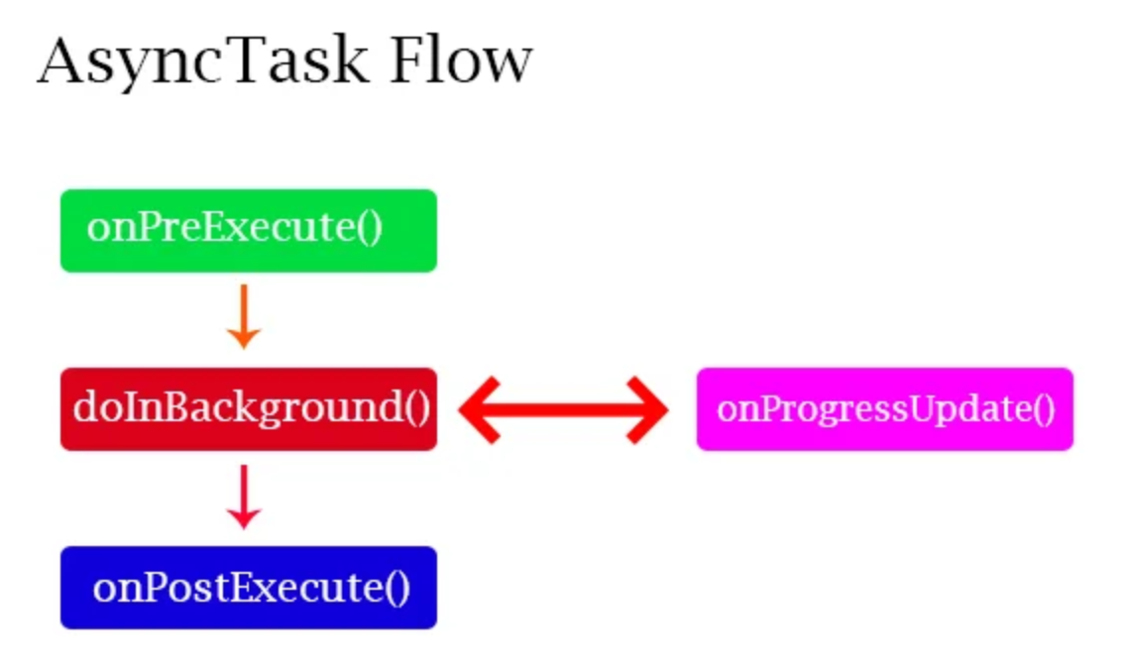
AsyncTask

Slide 6
Syntax of AsyncTask In Android:
The three types used by Asynchronous task are the following:
AsyncTask <TypeOfVarArgParams, ProgressValue, ResultValue>
TypeOfVarArgParams: Params is the type of the parameters sent to the task upon execution.
ProgressValue: Progress is the type of the progress units published during the background computation.
ResultValue: ResultValue is the type of the result of the background computation.

Slide 7
Syntax of AsyncTask class:
private class class_name extends AsyncTask<URL, Integer, Long>
{
protected Long doInBackground(URL... urls)
{
// code that will run in the background return ;
}
protected void onProgressUpdate(Integer... progress)
{
// receive progress updates from doInBackground
}
protected void onPostExecute(Long result)
{
// update the UI after background processes completes
}
}

Slide 8
Executions of AsyncTask class from main thread:
new DownloadFilesTask().execute(url1, url2, url3);
AsyncTask’s generic types In Android:

Slide 9
Method of AsyncTask In Android:
In Android, AsyncTask is executed and goes through four different steps or method. Here are these four methods of AsyncTasks.
onPreExecute() – It invoked on the main UI thread before the task is executed. This method is mainly used to setup the task for instance by showing a ProgressBar or ProgressDialog in the UI(user interface).
2. doInBackground(Params) – This method is invoked on the background thread immediately after onPreExecute() finishes its execution.
Main purpose of this method is to perform the background operations that can take a long time. The parameters of the Asynchronous task are passed to this step for execution.
The result of the operations must be returned by this step and it will be passed back to the last step/method i.e onPostExecutes(). This method can also use publishProgress(Progress…) to publish one or more units of progress.
These values will be published on the main UI thread in the onProgressUpdate(Progress…) method.
3. onProgressUpdate(Progress…) – This method is invoked on the main UI thread after a call to publishProgress(Progress…). Timing of the execution is undefined. This method is used to display any form of progress in the user interface while the background operations are executing. We can also update our progress status for good user experience.
4. onPostExecute(Result) – This method is invoked on the main UI thread after the background operation finishes in the doInBackground method. The result of the background operation is passed to this step as a parameter and then we can easily update our UI to show the results.

Slide 10
Example
public class MainActivity extends AppCompatActivity
{
protected void onCreate(Bundle savedInstanceState)
{
super.onCreate(savedInstanceState); setContentView(R.layout.activity_main);
DemoAsync obj = new DemoAsync; Obj.execute(10);
}
private static class DemoAsync extends AsyncTask<Integer, Integer, String>
{
protected void onPreExecute()
{
super.onPreExecute();
// ... }
protected String doInBackground(Integer... integers)
{ // ... return "Finished!";
}
protected void onProgressUpdate(Integer... values)
{
super.onProgressUpdate(values);
// ... }
protected void onPostExecute(String string)
{
super.onPostExecute(string);
// ...
}
} }

Slide 11
Example-2
<?xml version="1.0" encoding="utf-8"?>
<RelativeLayout xmlns:android="http://schemas.android.com/apk/res/android" xmlns:tools="http://schemas.android.com/tools"
android:layout_width="match_parent"
android:layout_height="match_parent"
android:padding="16dp"
tools:context=".MainActivity">
<Button android:id="@+id/startButton"
android:layout_width="wrap_content"
android:layout_height="wrap_content"
android:text="Start Task"
android:layout_centerHorizontal="true"
android:layout_marginTop="50dp"/>
<TextView android:id="@+id/resultTextView"
android:layout_width="wrap_content"
android:layout_height="wrap_content"
android:layout_below="@id/startButton"
android:layout_centerHorizontal="true"
android:layout_marginTop="20dp"
android:textSize="18sp"
android:text="Result will appear here."/>
</RelativeLayout>

Slide 12
.java class
// Define your AsyncTask
private class MySimpleAsyncTask extends AsyncTask<String, Void, String> {
protected void onPreExecute() {
super.onPreExecute();
// This runs on the UI thread before doInBackground
resultTextView.setText("Task started...");
startButton.setEnabled(false); // Disable button during task
}
protected String doInBackground(String... params) {
// This runs on a background thread
String input = params[0]; // Get input from execute()
try {
Thread.sleep(3000); // Simulate a long-running task
} catch (InterruptedException e) {
e.printStackTrace();
}
return "Task completed with input: " + input; // Return result
}
protected void onPostExecute(String result) {
super.onPostExecute(result);
// This runs on the UI thread after doInBackground completes
resultTextView.setText(result);
startButton.setEnabled(true); // Re-enable button
}
}
}
import android.os.AsyncTask;
import android.os.Bundle;
import android.view.View;
import android.widget.Button;
import android.widget.TextView;
import androidx.appcompat.app.AppCompatActivity;
public class MainActivity extends AppCompatActivity {
private Button startButton;
private TextView resultTextView;
@Override
protected void onCreate(Bundle savedInstanceState) {
super.onCreate(savedInstanceState);
setContentView(R.layout.activity_main);
startButton = findViewById(R.id.startButton);
resultTextView = findViewById(R.id.resultTextView);
startButton.setOnClickListener(new View.OnClickListener() {
@Override
public void onClick(View v) {
// Execute the AsyncTask when the button is clicked
new MySimpleAsyncTask().execute("Input data for task");
}
});
}

Slide 13
AsyncTask using HTTP
<?xml version="1.0" encoding="utf-8"?>
<RelativeLayout xmlns:android="http://schemas.android.com/apk/res/android"
xmlns:tools="http://schemas.android.com/tools"
android:layout_width="match_parent"
android:layout_height="match_parent"
android:paddingLeft="16dp"
android:paddingTop="16dp"
android:paddingRight="16dp"
android:paddingBottom="16dp"
tools:context=".MainActivity">
<Button
android:id="@+id/fetchDataButton"
android:layout_width="wrap_content"
android:layout_height="wrap_content"
android:text="Fetch Data"
android:layout_centerHorizontal="true"
android:layout_marginTop="50dp" />
<TextView
android:id="@+id/resultTextView"
android:layout_width="wrap_content"
android:layout_height="wrap_content"
android:layout_below="@id/fetchDataButton"
android:layout_centerHorizontal="true"
android:layout_marginTop="30dp"
android:text="Result will appear here"
android:textSize="18sp" />
</RelativeLayout>

Slide 14
Java file
package com.example.myapplication;
import android.os.AsyncTask;
import android.os.Bundle;
import android.view.View;
import android.widget.Button;
import android.widget.TextView;
import androidx.appcompat.app.AppCompatActivity;
import java.io.BufferedReader;
import java.io.IOException;
import java.io.InputStream;
import java.io.InputStreamReader;
import java.net.HttpURLConnection;
import java.net.URL;
public class MainActivity extends AppCompatActivity {
private Button fetchDataButton;
private TextView resultTextView;
@Override
protected void onCreate(Bundle savedInstanceState) {
super.onCreate(savedInstanceState);
setContentView(R.layout.activity_main);
fetchDataButton = findViewById(R.id.fetchDataButton);
resultTextView = findViewById(R.id.resultTextView);
fetchDataButton.setOnClickListener(new View.OnClickListener() {
@Override
public void onClick(View v) {
new FetchDataTask().execute("https://jsonplaceholder.typicode.com/todos/1");
}
});
}

Slide 15
Continue….
private class FetchDataTask extends AsyncTask<String, Void, String> {
@Override
protected void onPreExecute() {
super.onPreExecute();
resultTextView.setText("Fetching data...");
}
@Override
protected String doInBackground(String... urls) {
String result = null;
HttpURLConnection urlConnection = null;
BufferedReader reader = null;
try {
URL url = new URL(urls[0]);
urlConnection = (HttpURLConnection) url.openConnection();
urlConnection.setRequestMethod("GET");
urlConnection.connect();
InputStream inputStream = urlConnection.getInputStream();
if (inputStream == null) {
return null;
}
reader = new BufferedReader(new InputStreamReader(inputStream));
StringBuilder buffer = new StringBuilder();
String line;
while ((line = reader.readLine()) != null) {
buffer.append(line).append("\n");
}
if (buffer.length() == 0) {
return null;
}
result = buffer.toString();
} catch (IOException e) {
e.printStackTrace();
return null;
} finally {
if (urlConnection != null) {
urlConnection.disconnect();
}
if (reader != null) {
try {
reader.close();
} catch (final IOException e) {
e.printStackTrace();
}
}
}
return result;
}
@Override
protected void onPostExecute(String result) {
super.onPostExecute(result);
if (result != null) {
resultTextView.setText(result);
} else {
resultTextView.setText("Error fetching data.");
}
}
}
}

Slide 16
AndroidManifest.xml (Permissions)
Add the internet permission inside the <manifest> tag:
<uses-permission android:name="android.permission.INTERNET" />
Alternative of AsyncTask :
Java java.util.concurrent Utilities (Executors and Handlers):
This approach uses ExecutorService (created with Executors) to run background tasks and a Handler (associated with Looper.getMainLooper()) to post results back to the UI thread.
It provides a similar separation of background and UI work as AsyncTask but with more control and flexibility.

Slide 17
SMS and Email
There are three very important features of Android that are SMS, Email and the Call.
The SMS is a Short Message Service. It is a messaging service in Android. It is send a messages to a particular contact number. This is provided to us by Android in two ways –
Using the SMSManager API.
Using the Built-In application for sending messages.

Slide 18
Send SMS using SMSManager API
SmsManager smsmanage = SmsManager.getDefault();
smsmanage.sendTextMessage(“Phone Number”, null, “The message to be sent”, null, null);
For this, we would need to set permission to send SMS in the Manifest file.
<uses-permission android:name="android.permission.SEND_SMS"/>

Slide 19
Built-in application Intent for SMS:
Intent smsIntent = new Intent(Intent.ACTION_VIEW);
smsIntent.putExtra("...Message...", "...default content...");
smsIntentt.setType("vnd.android-dir/mms-sms");
startActivity(sendIntent);
For this too, we would need to set permission to send SMS in the Manifest file.
<uses-permission android:name="android.permission.SEND_SMS"/>

Slide 20
Example:MainActivity.java
import android.Manifest;
import android.app.Activity;
import android.content.pm.PackageManager;
import android.os.Bundle;
import android.telephony.SmsManager;
import android.view.View;
import android.widget.Button;
import android.widget.EditText;
import android.widget.Toast;
import androidx.core.app.ActivityCompat;
import androidx.core.content.ContextCompat;
public class MainActivity extends Activity {
private static final int PERMISSION_RQST_SEND = 0;
Button button1;
EditText phoneNo;
EditText myMessage;
String phoneNo;
String message;
@Override
protected void onCreate(Bundle savedInstanceState) {
super.onCreate(savedInstanceState);
setContentView(R.layout.activity_main);
button1 = (Button) findViewById(R.id.btnSendSMS);
phoneNo = (EditText) findViewById(R.id.editText);
myMessage = (EditText) findViewById(R.id.editText2);
button1.setOnClickListener(new View.OnClickListener() {
public void onClick(View view) {
sendSMSMessage();
}
});
}

Slide 21
Continue
protected void sendSMSMessage() {
phoneNo = phoneNo.getText().toString();
//we’ll get the phone number from the user
message = myMessage.getText().toString();
//we’ll get the Message from the user
//We’ll check the permission is granted or not . If not we’ll change
if (ContextCompat.checkSelfPermission(this,Manifest.permission.SEND_SMS) != PackageManager.PERMISSION_GRANTED) {
if (ActivityCompat.shouldShowRequestPermissionRationale(this,Manifest.permission.SEND_SMS)) {
}
else { ActivityCompat.requestPermissions(this, new String[]{Manifest.permission.SEND_SMS}, PERMISSION_RQST_SEND);
}
}
}
//Now once the permission is there or not would be checked
@Override
public void onRequestPermissionsResult(int requestCode, String permissions[], int[] grantResults) {
switch (requestCode) {
case PERMISSION_RQST_SEND: {
if (grantResults.length > 0 && grantResults[0] == PackageManager.PERMISSION_GRANTED) {
SmsManager smsManager = SmsManager.getDefault();
smsManager.sendTextMessage(phoneNo, null, message, null, null);
Toast.makeText(getApplicationContext(), "SMS sent.",Toast.LENGTH_LONG).show();
} else {Toast.makeText(getApplicationContext(), "SMS failed, you may try again later.", Toast.LENGTH_LONG).show();
return;
}
}
}
}

Slide 22
Manifest.xml
<?xml version="1.0" encoding="utf-8"?>
<manifest xmlns:android="http://schemas.android.com/apk/res/android"
package="com.DataFlair.smssample">
<uses-permission android:name="android.permission.SEND_SMS" />
<application
android:allowBackup="true"
android:icon="@mipmap/ic_launcher"
android:label="@string/app_name"
android:roundIcon="@mipmap/ic_launcher_round"
android:supportsRtl="true"
android:theme="@style/AppTheme">
<activity
android:name="com.DataFlair.smssample.MainActivity"
android:label="@string/app_name">
<intent-filter>
<action android:name="android.intent.action.MAIN" />
<category android:name="android.intent.category.LAUNCHER" />
</intent-filter>
</activity>
<meta-data
android:name="preloaded_fonts"
android:resource="@array/preloaded_fonts" />
</application>
</manifest>

Slide 23
Email
Android Application that can be used to send email through your android application. You can do so with the help of Implicit Intent with action as ACTION_SEND with extra fields:
email id to which you want to send mail,
the subject of the email, and
body of the email.
Basically Intent is a simple message object that is used to communicate between android components such as activities, content providers, broadcast receivers, and services, here use to send the email.

Slide 24
Example
<?xml version="1.0" encoding="utf-8"?>
<RelativeLayout xmlns:android="http://schemas.android.com/apk/res/android"
xmlns:tools="http://schemas.android.com/tools"
android:layout_width="match_parent"
android:layout_height="match_parent"
android:background="@color/white"
tools:context=".MainActivity">
<EditText
android:id="@+id/editText1"
android:layout_width="200dp"
android:layout_height="wrap_content"
android:layout_alignParentTop="true"
android:layout_alignParentEnd="true"
android:layout_marginTop="100dp"
android:layout_marginEnd="22dp" />
<EditText
android:id="@+id/editText2"
android:layout_width="200dp"
android:layout_height="wrap_content"
android:layout_below="@+id/editText1"
android:layout_alignStart="@+id/editText1"
android:layout_marginTop="20dp" />
<EditText
android:id="@+id/editText3"
android:layout_width="200dp"
android:layout_height="wrap_content"
android:layout_below="@+id/editText2"
android:layout_alignStart="@+id/editText2"
android:layout_marginTop="30dp" />
<TextView
android:id="@+id/textView1"
android:layout_width="wrap_content"
android:layout_height="wrap_content"
android:padding="16dp"
android:textSize="18sp"
android:textStyle="bold"
android:layout_alignBaseline="@+id/editText1"
android:layout_alignBottom="@+id/editText1"
android:layout_alignParentStart="true"
android:text="Send To:"
android:textColor="@color/green" />
<TextView
android:id="@+id/textView2"
android:layout_width="wrap_content"
android:layout_height="wrap_content"
android:padding="16dp"
android:textSize="18sp"
android:textStyle="bold"
android:layout_alignBaseline="@+id/editText2"
android:layout_alignBottom="@+id/editText2"
android:layout_alignParentStart="true"
android:text="Email Subject:"
android:textColor="@color/green" />
<TextView
android:id="@+id/textView3"
android:layout_width="wrap_content"
android:layout_height="wrap_content"
android:padding="16dp"
android:textSize="18sp"
android:textStyle="bold"
android:layout_alignBaseline="@+id/editText3"
android:layout_alignBottom="@+id/editText3"
android:text="Email Body:"
android:textColor="@color/green" />
>
<Button
android:id="@+id/button"
android:layout_width="wrap_content"
android:layout_height="wrap_content"
android:layout_below="@+id/editText3"
android:layout_centerHorizontal="true"
android:textSize="24sp"
android:layout_marginTop="20dp"
android:backgroundTint="@color/green"
android:text="Send email!!" />
</RelativeLayout

Slide 25
Java file
// Set OnClickListener for the button
button.setOnClickListener(new View.OnClickListener() {
@Override
public void onClick(View v) {
String emailSend = sendTo.getText().toString();
String emailSubject = subject.getText().toString();
String emailBody = body.getText().toString();
// Define Intent object with action attribute as ACTION_SEND
Intent intent = new Intent(Intent.ACTION_SEND);
// Add email details using putExtra
intent.putExtra(Intent.EXTRA_EMAIL, new String[]{emailSend});
intent.putExtra(Intent.EXTRA_SUBJECT, emailSubject);
intent.putExtra(Intent.EXTRA_TEXT, emailBody);
// Set the type of intent
intent.setType("message/rfc822");
// Start the activity with a chooser for email clients
startActivity(Intent.createChooser(intent, "Choose an Email client :"));
}
});
}
}
package org.geeksforgeeks.demo;
import android.content.Intent;
import android.os.Bundle;
import android.view.View;
import android.widget.Button;
import android.widget.EditText;
import androidx.appcompat.app.AppCompatActivity;
public class MainActivity extends AppCompatActivity {
// Declare EditText and Button objects
private Button button;
private EditText sendTo;
private EditText subject;
private EditText body;
@Override
protected void onCreate(Bundle savedInstanceState) {
super.onCreate(savedInstanceState);
setContentView(R.layout.activity_main);
// Initialize EditText and Button
sendTo = findViewById(R.id.editText1);
subject = findViewById(R.id.editText2);
body = findViewById(R.id.editText3);
button = findViewById(R.id.button);

Slide 26
Location-based services
Location-based services are present in android to provide you with feature like current location detection , display near by places etc.
So, location based service is the feature that android that provides us using the location frame work. This Framework provides us certain classes and interfaces , which are the key components.
These components make it easier for us to implement the location feature in our application.

Slide 27
Component of location based services in android
LocationManager Class- It Helps to get location services of the system.
LocationListner interface- It receives notifications from the manager.
LocationProvider- devices provides a location from a set of providers
Location class – it represent the geographical location at a particular time.

Slide 28
Location Object
The location object store the geographical location of the device in term of longitude, latuitude , altitude, velocity, etc.
Service Provider: there are two service provider for accessing the location information.
GPS provider, Use information provided by satellites to identify location
Cell(Network provider)or WIFI- use cell tower information or wifi hostspots to approximate the location. The provider retrieves an approximate location by querying the googlelocation server using the IDs of the wifi of the hostspot and cell tower.

Slide 29
Network vs. GPS
Network location provider is comparatively faster than the GPS provider in providing the location co-ordinates
GPS provider may be very slow in in-door locations and will drain mobile battery.
Network location provider depands on the cell tower and will return our nearest tower location. Location accuracy in b/w 100m-1000m.
GPS location provider , will give our location accurately. It provides location updates through satellites.

Slide 30
Steps to get location in android
Create LocationManager instance as reference to the location services
LocationManager LM=(LocationManager)getSystemService(Context.LOCATION_SERVICE)
2. Identify the Location provider to used to retrieving details . The location provider actually provides the location data in android .
Android exposes two main location providers: GPS_PROVIDER and NETWORK_PROVIDER
String provider =LocationManager.GPS_PROVIDER.
Or
String provider= LocationManager.NETWORK_PROVODER
3. Provide Permission in Manifest.XML file for receiving location update

Slide 31
Displaying Google Maps:
To integrate Google Maps into an application, developers typically utilize the Google Maps Platform APIs, such as the Maps SDK for Android or iOS, or the Maps JavaScript API for web applications. This involves:
Obtaining an API key
Setting up the environment
Integrating the map

Slide 32
Continue
A Google Maps API key is required and obtained through the Google Cloud Console.
The API key is configured within the application's project, often in the manifest file for mobile apps or within a script tag for web applications.
A map view or component is added to the application's user interface, and the API is used to initialize and display the map.

Slide 33
UNIT-5
Android application development involves two key stages before the app reaches the end user: thorough testing to ensure quality and stability, and the formal publishing process, typically via the Google Play Store.
Testing Android Applications:
Testing is an integral part of the development lifecycle, ensuring the app is functional, performs well, and is secure across various devices and network conditions.

Slide 34
Types of Testing
Unit Testing: Focuses on testing individual components, such as methods or classes, in isolation, typically on the local machine (JVM).
Integration Testing: Verifies that different modules or components of the application interact and work correctly with each other (e.g., between UI and database).
Functional/UI Testing: Assesses whether the app's features function according to their intended purpose and user flows. It involves simulating user interactions with the UI.
Performance Testing: Evaluates the app's responsiveness, speed, stability, and resource consumption (CPU, memory, battery) under various conditions and loads.
Security Testing: Identifies vulnerabilities and weaknesses that could compromise the app's security and user data (e.g., SQL injection, insecure data storage).
Compatibility Testing: Ensures the app functions correctly across a wide range of devices, screen sizes, and Android OS versions.
User Acceptance Testing (UAT)/Beta Testing: Involves real users testing the app in a real-world environment to provide feedback on usability and functionality before the final release.

Slide 35
Android Testing Frameworks
Android provides several tools and frameworks to facilitate different types of testing:
JUnit: A popular framework for writing unit tests in Java, often used for local unit tests that run on the JVM.
Robolectric: Allows running unit tests for Android components directly on the JVM without an emulator or a physical device, increasing test speed and reliability.
Espresso: A framework for writing concise, reliable automated UI tests within a single application. It automatically synchronizes test actions with the app's UI thread.
UI Automator: Designed for functional UI testing across multiple apps and system components. It provides APIs to interact with UI elements and is useful for black-box testing scenarios.
Appium: An open-source, cross-platform framework for testing native and hybrid mobile apps, supporting multiple programming languages.
Firebase Test Lab: A cloud-based service that allows testing an app on a wide variety of real physical and virtual devices.

Slide 36
Publishing Android Applications
Preparing the Application for Release: Before publishing, the app needs to be configured and finalized for a production environment.
Gather Materials: Prepare necessary items such as an app icon (512x512 PNG), an end-user license agreement (EULA), a privacy policy, and promotional graphics and text for the store listing.
Configure for Release:
Choose a unique application ID that cannot be changed later.
Turn off debugging and logging (e.g., remove Log calls and set debuggable false in Gradle).
Enable code and resource shrinking (R8 or ProGuard) to optimize the app size.
Review and update the AndroidManifest.xml file and Gradle settings, ensuring correct permissions, icons, versionCode, and versionName are set.
Ensure the app targets the required API level set by Google Play.
Build and Sign the App: Create a release version of the app using an Android App Bundle (AAB) or APK file. The app must be digitally signed with a cryptographic key (keystore) to verify its authenticity and ensure secure updates.
Final Testing: Conduct a final round of testing on the release version, preferably on a range of physical devices, to ensure stability and performance in real-world conditions.

Slide 37
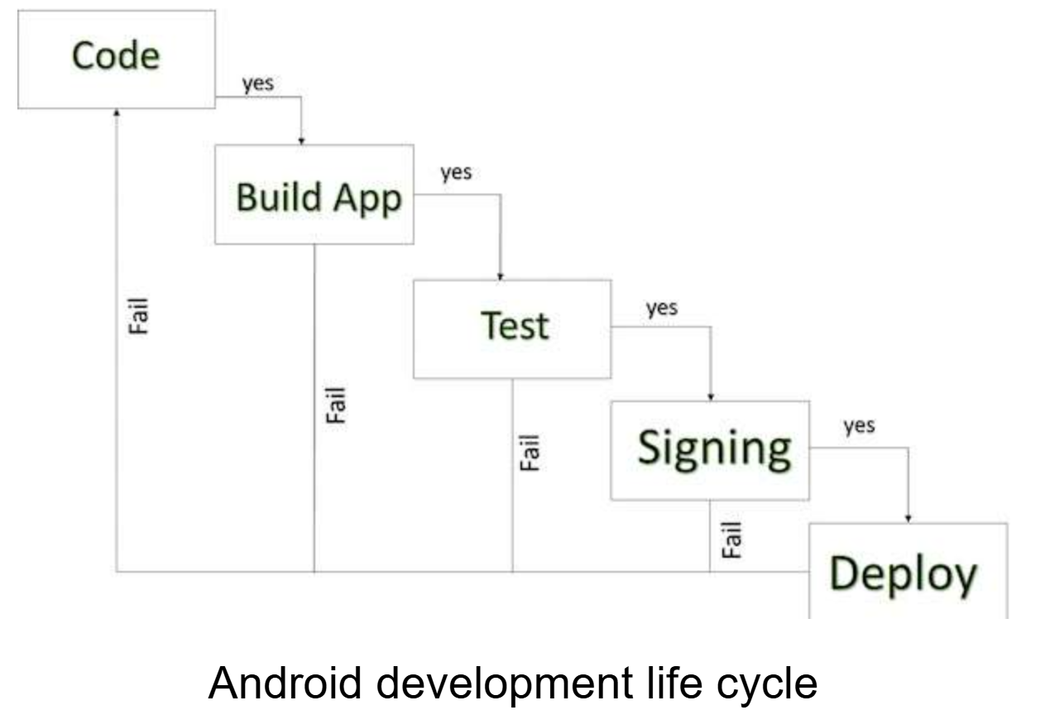
Android application publishing is a process that makes your Android applications available to users. Infect, publishing is the last phase of the Android application development process.

Slide 38
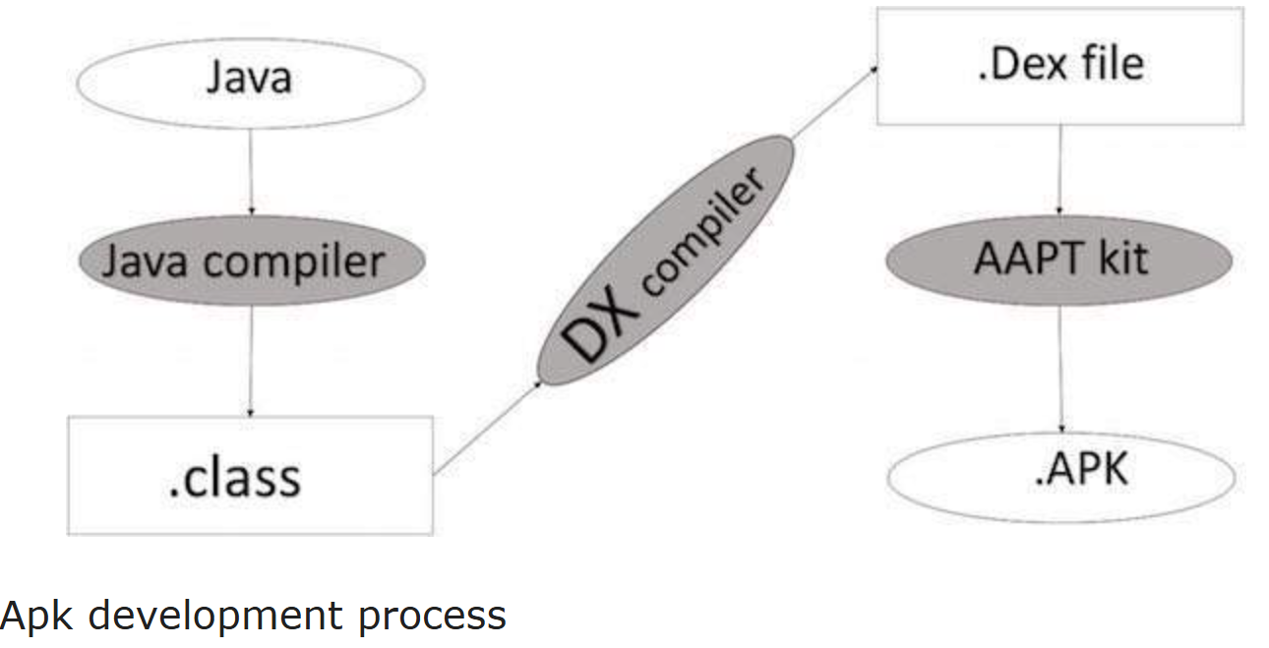
Export Android Application Process

Slide 39
Before exporting the apps, you must some of tools
Dx tools(Dalvik executable tools ): It going to convert .class file to .dex file. it has useful for memory optimization and reduce the boot-up speed time
AAPT(Android assistance packaging tool):it has useful to convert .Dex file to.Apk
APK(Android packaging kit): The final stage of deployment process is called as .apk.
You will need to export your application as an APK (Android Package) file before you upload it Google Play marketplace.
To export an application, just open that application project in Android studio and select Build → Generate Signed APK from your Android studio and follow the simple steps to export your application.
Next select, Generate Signed APK option as shown in the above screen shot and then click it so that you get following screen where you will choose Create new keystore to store your application.
Enter your key store path,key store password,key alias and key password to protect your application and click on Next button once again. It will display following screen to let you create an application
. Once you filled up all the information,like app destination,build type and flavours click finish button While creating an application it will show as below
Finally, it will generate your Android Application as APK formate File which will be uploaded at Google Play marketplace.

Slide 40
Releasing the Android Application to the Users
The primary method for distribution is the Google Play Store, involving these steps:
Create a Google Play Developer Account: Sign up and pay a one-time registration fee on the Play Console.
Set up the App Listing: In the Play Console, create a new app, provide details like the app's name, category, full description, content rating, pricing, and distribution countries.
Upload the App Bundle: Upload the signed release AAB (Android App Bundle) file to a specific track (internal testing, closed testing, open testing, or production).
Manage Testers (Optional but Recommended): Utilize the testing tracks to gather feedback and fix issues with limited user groups before a full public release.
Publish the App: Once satisfied with testing and configuration, roll out the application to the production track. Google Play will review the app for policy compliance (which can take a few hours to several days), after which it becomes available for users to download.

Slide 41
Google Play Registration
The most important step is to register with Google Play using Google Play Marketplace. You can use your existing google ID if you have any otherwise you can create a new Google ID and then register with the marketplace. You will have following screen to accept terms and condition.
You can use Continue to payment button to proceed to make a payment of $25 as a registration fee and finally to complete your account detail.
Once you are a registered user at Google Play, you can upload release-ready APK for your application and finally you will complete application detail using application detail page as mentioned in step 9 of the above mentioned checklist.

